Slide 1


Slide 2



Slide 3
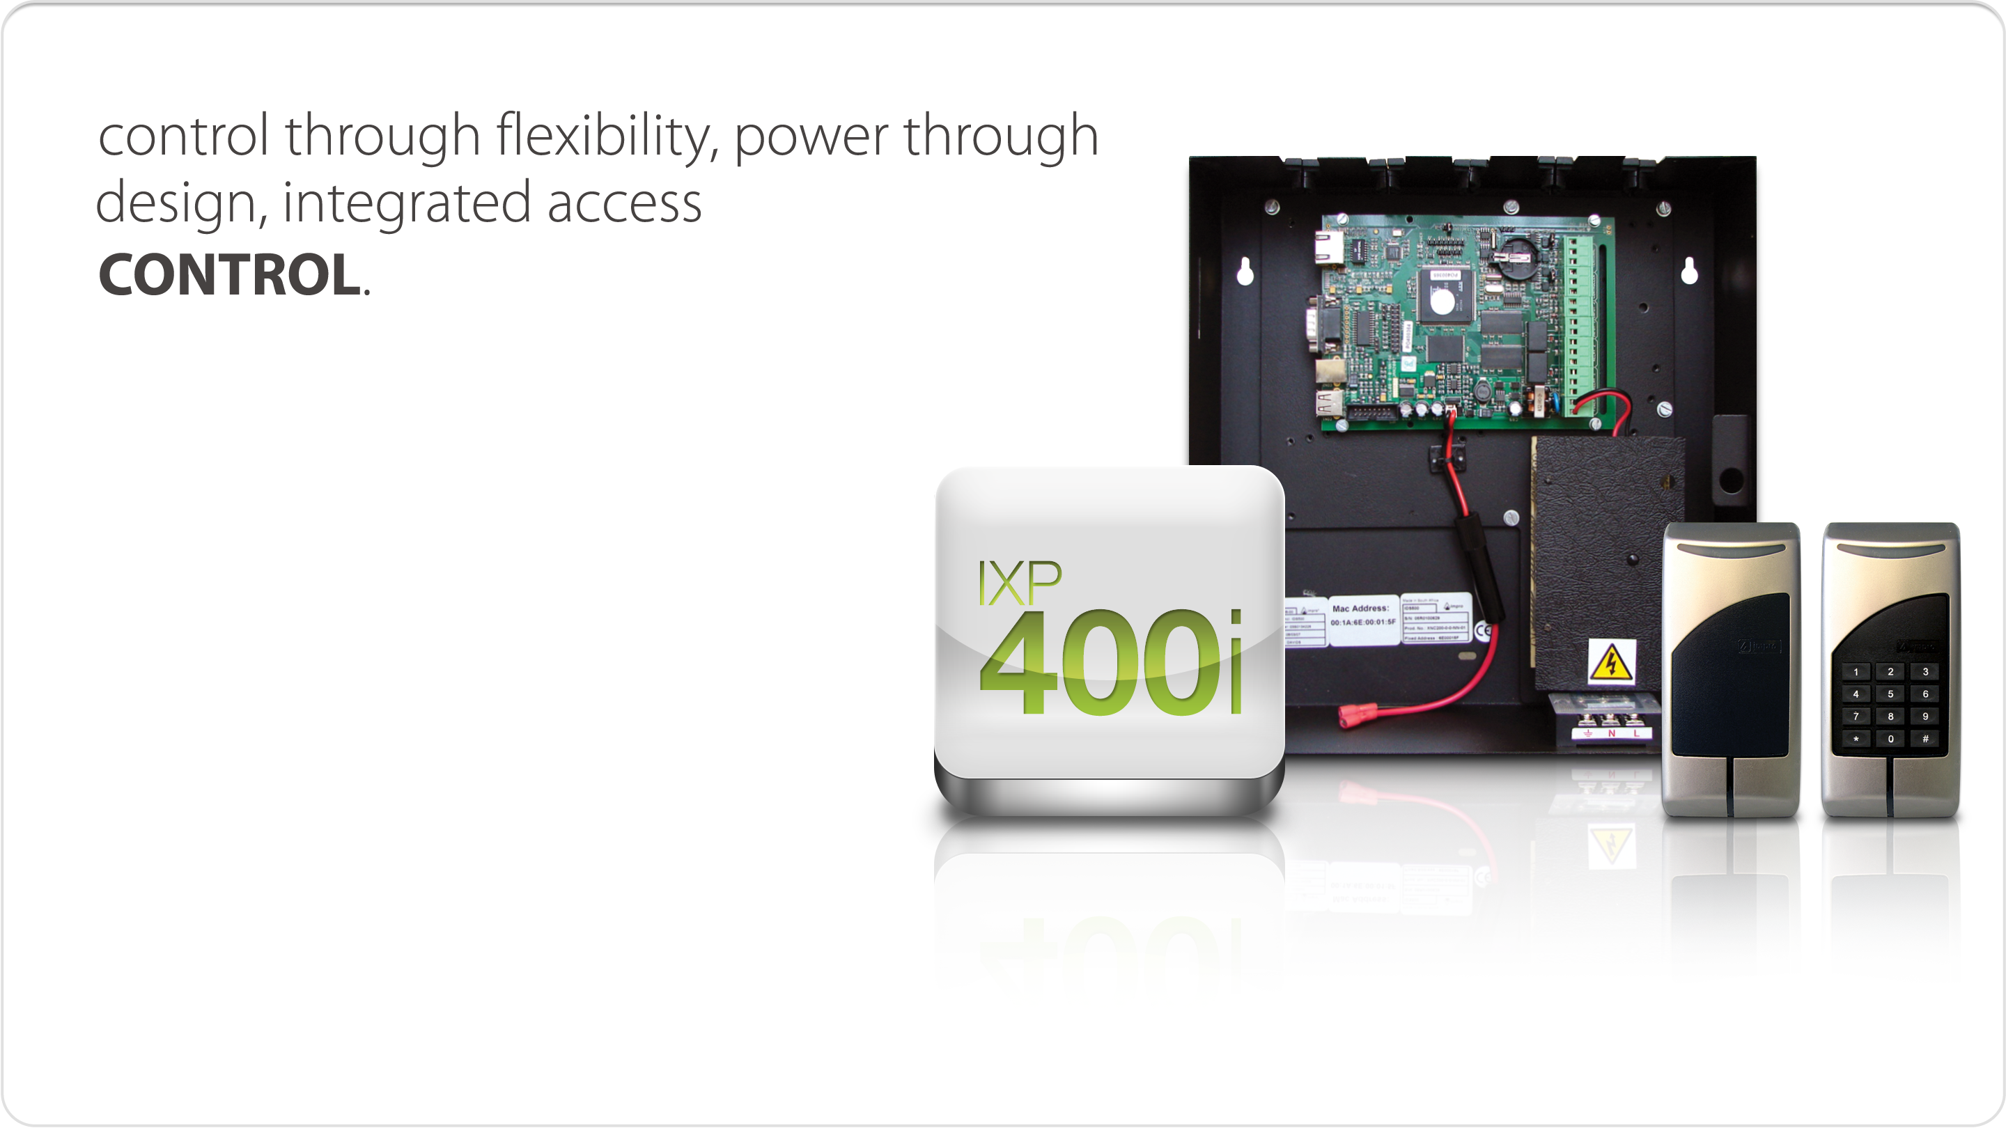
Introduction
Target Market: High Level Enterprise
Description: The Flagship system for
large enterprises allowing
customised integration.
Applications:
The IXP400i has the capacity and ability to
control sites of all sizes and requirements. Its
industry leading flexibility and integration
options allow it to be configured to any custom
requirement.

Slide 4
Introduction
Applications include:
• Petrochemical
• University complexes
• Healthcare
• Large Industrial
• Multi-site applications
• Gated communities
• Time and Attendance
• Centralised Remote Site Management
• Production Management
• Multi-site applications
• Gated communities
• Time and Attendance
• Centralised Remote Site Management
• Production Management
These include:
• Staff
• Contractors
• Visitors
• Vehicles
• Time clocking using fingerprint
For Control of:
The flexibility offered through the hardware architecture, variety of compatible reader options and features allow the IXP400i to be used in a large number of applications.

Slide 5
Features
STANDARD FEATURES WITH IXP400i BASE APPLICATION
  Graphical User Interface for complete site control
  Full off-line functionality with multi-layer redundancy
  User Customised Operator Security
  Seamless Biometric Integration
  Seamless CCTV Integration
  Building management
  Random search
  Dual Tag Entry for High Security
  Access Control for Vehicles
  Card Printing Module
  Elevator Control
  Tracker
  3rd Intrusion Alarm Integration
  3rd Fire or Emergency Integration
  Web based Employee and Visitor enrolment
  Web based reports
  Door Mode Patterns
  Time Triggered Actions
  Event Triggered Actions
  Access Groups
  Zone routing
  Zone counting
  Configurable emergency unlock sequence
  Programmable Holidays
  Tag Programming
  Duress Codes
  Multiple Tags per Tagholder
  Tag Suspension Facilities
  Anti-passback Control
  SQL Compatible Open Database
  Auto Hardware Configuration
  TCP/IP Controllers

Slide 6
Features
OPTIONAL FEATURES
• SQL Server (upgrade for engine)
• SQL Server (upgrade for access)
• CCTV Integration
• Biometrics Integration
• Intrusion Alarm Integration
• SMS Integration
• Virtual I/O
WHY THE IXP400i IS THE SYSTEM FOR YOU
The IXP400i has built a name in the market as the solution system. Its customisable event and action driven foundation and extensive feature set allows the system to be setup to solve the most complex site requirements.
In addition the list of integration options available in the system and factory developed integrations help create this powerful platform that allows the seamless linking of 3rd party systems and devices to create a single logon approach to security.
The IXP400i is a class-leading solution that will meet your budgetary and site requirements while offering an excellent return on investment.

Slide 7
Integration Platform
INTEGRATION PLATFORM
The IXP400i has been designed to be the base for an integrated solution. The IXP400i embraces the concept of a single logon
approach to security management.
Regardless of the complimentary system that is added to the IXP400i backbone the software is able to be configured to offer a seamless interconnection to the 3rd party solution.
This interconnectivity offers a level of control that will elevate your security solution to an
all-encompassing management environment.
QUALITY CONSTRUCTION
All Impro hardware is manufactured to ISO9001:2008 standards using the latest in automated surface mount technology. The Impro brand has become synonymous with high quality hardware suited to all environments.
All Impro hardware used in the IXP400i system comes standard with a 3 year warranty with the
option to increase it to 5 years through Impro’s Client Services program.

Slide 8
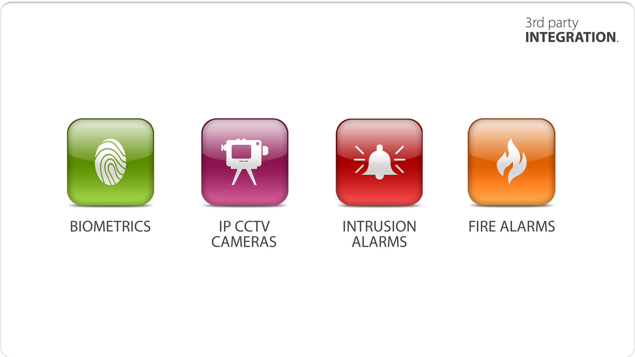
Integration

Slide 9


Parameters
^{• 300 000 Tagholders}
^{• 100 000 Buffer Transactions}
^{Siteper System Controller}
^{• 1 000 s per System}
• 64 System Controllers per Site
• 32 Doors per System Controller
^{• 3 000 anti-pass back doors}
^{per Site}
^{• 300 Time Triggered Actions}
^{• 10 Tags per Person}
^{• 64 Tagholder Access Groups}
^{• 8 Elevator / Lifts}
^{• 32 Elevator / Lifts – Floors}

Slide 10
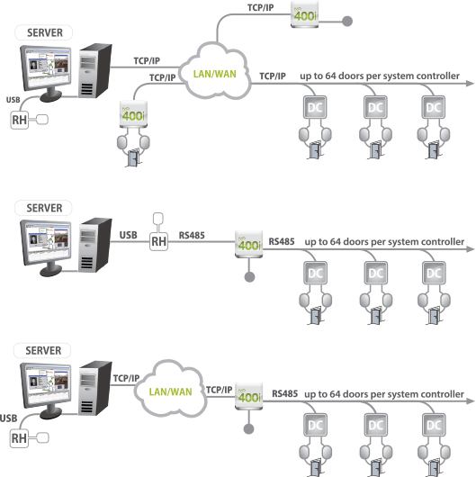

Architectural Diagrams
5 main components used in Impro Systems:
Software
System Controllers (SC)
Door Controllers (DC)
Readers
Tags

Slide 11
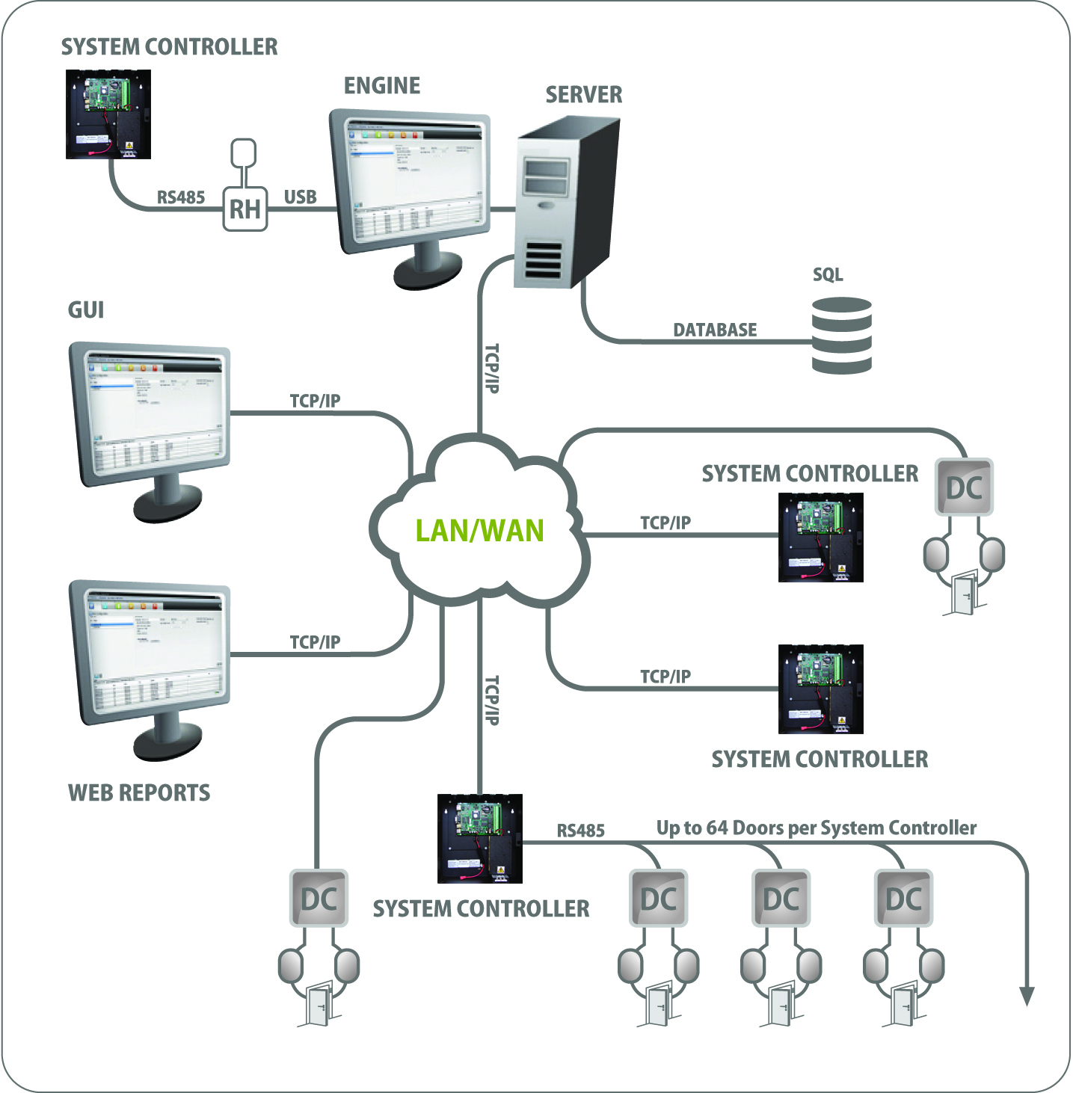
IXP400i Architecture Communication
One of the major strengths of the IXP400i is the flexible system architecture that is able to fit the requirements of any site.
Supporting multiple communication options simultaneously
on a single site
the configuration
options are endless.

Slide 12
IXP400i hardware COMPONENTS

Slide 13
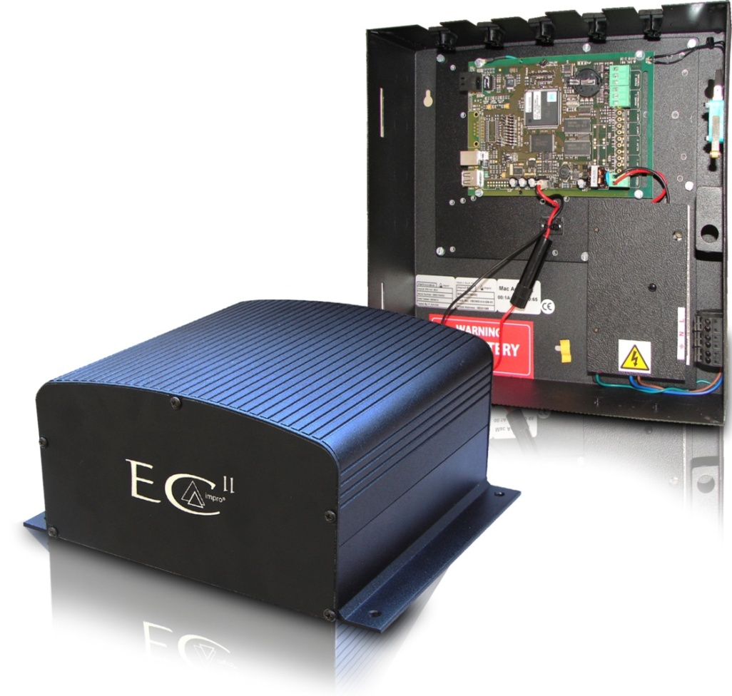
System Controllers
The ImproX (ECII) Ethernet Controller is a fully Ethernet compatible Controller for use in the IXP400i Access Control System:
    a mild steel cabinet OR
    extruded aluminium housing
ARM920T Microprocessor Core operating at
200 mips (million instructions per second).
Linux Operating System.
64 MB SDRAM Memory and 8 MB Flash Memory.
LEDs indicate transmit and receive line activity for diagnostics.
Remote Firmware download capability.
Supports a secure logon when changing Controller
Configuration settings using the Ethernet Discovery Utility.
An Ethernet Controller Port for connection to an
Ethernet Switch or Hub (or other network device).
An RS485 Controller Bus Port for connection to other
ImproX (EC^{II}) Ethernet Controllers.
An RS485 Terminal Bus Port for connection to up to 64 Terminal Fixed Addresses.
Operation from power inputs in the range 10 V DC to 30 V DC.
Fully network compatible (10/100/1 000 MBps over the WAN or LAN).
Power Input Fail and Battery Low signal reporting.
48 Hour Hibernation Mode for extended battery backup of the
ImproX (ECII) Ethernet Controllers database (including transactions).
IPS970-0-0-GB – IXP400i Ethernet Controller in power supply box – LAN/WAN & RS485 Connectivity
XEC900-0-0-GB – IXP400i Ethernet Controller in Aluminum Housing

Slide 14
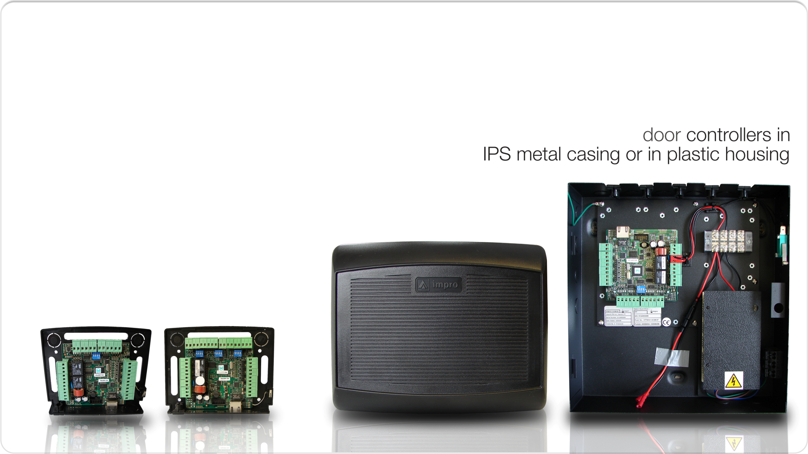
Door Controllers
Full off-line validation functionality
Tag capacity:
  RS485 door controller – 1 000 (if more than 1 000 it will work
  on last 2 000 people that used the door) … learned pattern
  TCP/IP door controller – 10 000
Features supported while off-line:
  RTE
  Door open sensing
  Inhibit scanner (local connection only)
Zero down-time firmware upgrade
During a reset period of 30 seconds tags will not be read
offline functionality will not be supported.
Support 2 readers that can be configured
to control 1 door in/out or 2 doors single
entry PB to exit
iTT | iTRT

Slide 15
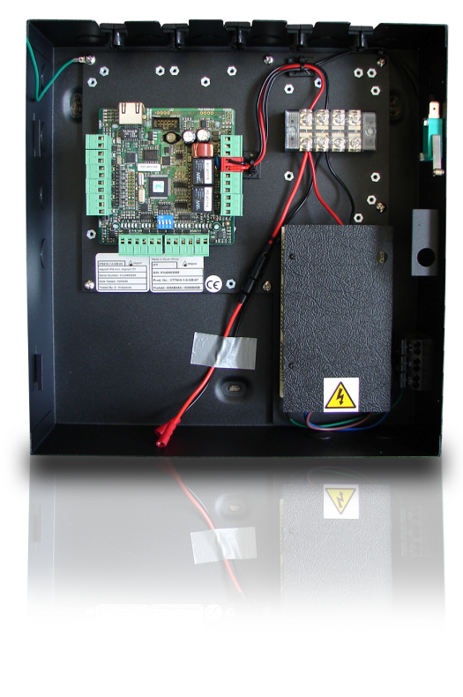
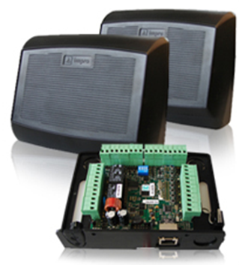
Door Controllers - Product Codes
door controller
in IPS metal housing
door controller
in plastic housing
iTT
iTRT
iTT
iTRT
RS485
TCP/IP
RS485
TCP/IP
RS485
TCP/IP
RS485
TCP/IP
IPS910-1-0-GB
IPS920-0-0-GB
XTT910-1-0-GB
XRT910-0-0-GB
IPS911-1-0-GB
IPS921-0-0-GB
XTT920-1-0-GB
XRT920-1-0-GB
Notes:
The 2nd Generation ImproX Door controllers (iTT and iTRT) comes in a IPS case (black, powder coated, steel housing) which includes a 3amp switch-mode power supply, with 2 way output connectors OR a plastic housing with an anti-tamper switch.
The 2nd Generation ImproX Intelligent (iTT) and (iTRT) – RS485 communicates with the System controller via RS485 only whereas the (iTT) and (iTRT) – 100mbps TCP/IP communicates with the System Controller via either 100mbps TCP/IP or RS485.
Take note of the pre-fix XTT/XRT used with the plastic housings and the IPS pre-fix with the ones with the integrated psu
CALL UP PRICELIST and show them where they can find the Door controllers

Slide 16
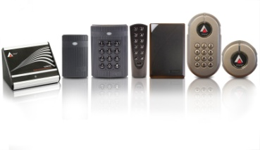

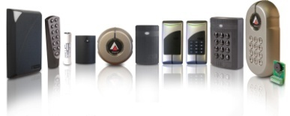

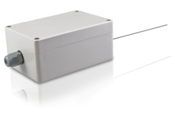
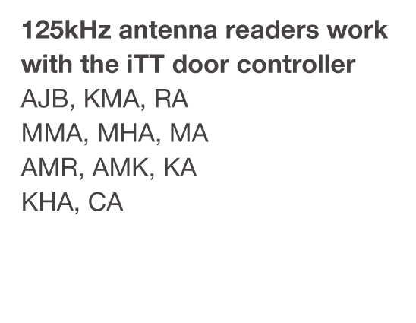
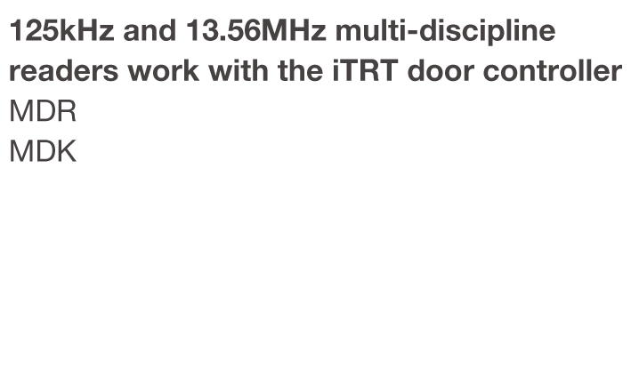
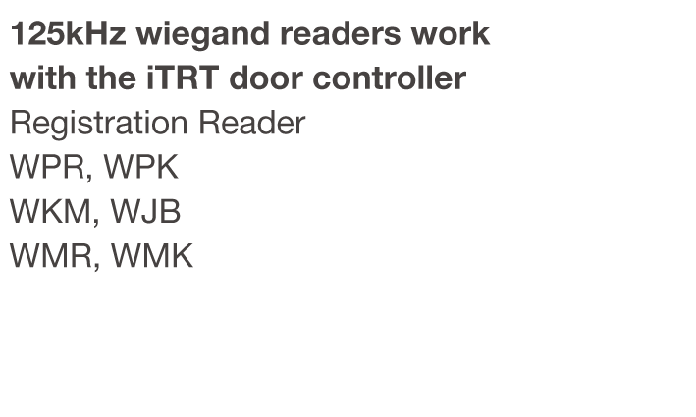
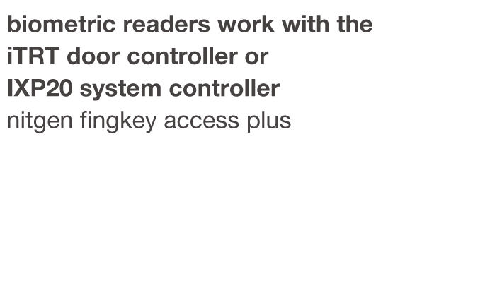
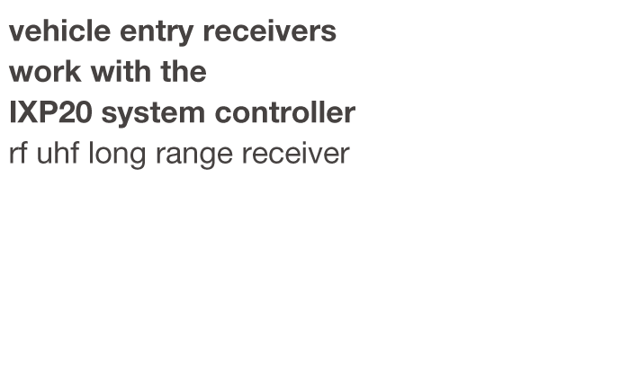
Readers
XTT901-1-0-GB
XTT950-1-0-GB
MDR900-5-0-GB 9 CORE PIGTAIL VERSION
WPR900-1-0-GB
NITGEN FINGKEY ACCESS PLUS
UHF900-1-0-GB
XTT902-1-0-GB
XTT951-1-0-GB
MDR901-5-0-GB 10 WAY TERMINAL BLOCK VERSION
WMR900-1-0-GB
XTT903-1-0-GB
XTT952-1-0-GB
MDK900-5-0-GB 9 CORE PIGTAIL VERSION
WMK900-1-0-GB
XTT904-1-0-GB
MDK901-5-0-GB 10 WAY TERMINAL BLOCK VERSION
WPK900-1-0-GB
XTT905-1-0-GB
WKM900-1-0-GB
XTT906-1-0-GB
WJB900-1-0-GB
XTT907-1-0-GB
XTT909-1-0-GB
IXP20TOUCH System Controllers iTRT Door Controller 125kHz Antenna Readers FINGKEY Access Plus I mpro provide a wide
IXP20NET System Controllers wiegand for 3rd party Wiegand Readers for 3rd party Biometric Reader range of high quality RFID
iTT Door Controller Multi- Discipline Readers tags for use with their range
reads 125kHz antenna readers of access control systems
Notes:
This is just to show images of all the different products … let animation finish

Slide 17
Readers
XTT901-1-0-GB
XTT950-1-0-GB
MDR900-5-0-GB 9 CORE PIGTAIL VERSION
WPR900-1-0-GB
NITGEN FINGKEY ACCESS PLUS
UHF900-1-0-GB
XTT902-1-0-GB
XTT951-1-0-GB
MDR901-5-0-GB 10 WAY TERMINAL BLOCK VERSION
WMR900-1-0-GB
XTT903-1-0-GB
XTT952-1-0-GB
MDK900-5-0-GB 9 CORE PIGTAIL VERSION
WMK900-1-0-GB
XTT904-1-0-GB
MDK901-5-0-GB 10 WAY TERMINAL BLOCK VERSION
WPK900-1-0-GB
XTT905-1-0-GB
WKM900-1-0-GB
XTT906-1-0-GB
WJB900-1-0-GB
XTT907-1-0-GB
XTT909-1-0-GB
IXP20TOUCH System Controllers iTRT Door Controller 125kHz Antenna Readers FINGKEY Access Plus I mpro provide a wide
IXP20NET System Controllers wiegand for 3rd party Wiegand Readers for 3rd party Biometric Reader range of high quality RFID
iTT Door Controller Multi- Discipline Readers tags for use with their range
reads 125kHz antenna readers of access control systems
Notes:
This is just to show images of all the different products … let animation finish

Slide 18
Readers
XTT901-1-0-GB
XTT950-1-0-GB
MDR900-5-0-GB 9 CORE PIGTAIL VERSION
WPR900-1-0-GB
NITGEN FINGKEY ACCESS PLUS
UHF900-1-0-GB
XTT902-1-0-GB
XTT951-1-0-GB
MDR901-5-0-GB 10 WAY TERMINAL BLOCK VERSION
WMR900-1-0-GB
XTT903-1-0-GB
XTT952-1-0-GB
MDK900-5-0-GB 9 CORE PIGTAIL VERSION
WMK900-1-0-GB
XTT904-1-0-GB
MDK901-5-0-GB 10 WAY TERMINAL BLOCK VERSION
WPK900-1-0-GB
XTT905-1-0-GB
WKM900-1-0-GB
XTT906-1-0-GB
WJB900-1-0-GB
XTT907-1-0-GB
XTT909-1-0-GB
IXP20TOUCH System Controllers iTRT Door Controller 125kHz Antenna Readers FINGKEY Access Plus I mpro provide a wide
IXP20NET System Controllers wiegand for 3rd party Wiegand Readers for 3rd party Biometric Reader range of high quality RFID
iTT Door Controller Multi- Discipline Readers tags for use with their range
reads 125kHz antenna readers of access control systems
Notes:
This is just to show images of all the different products … let animation finish

Slide 19
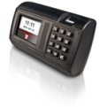
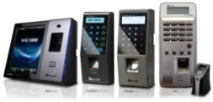
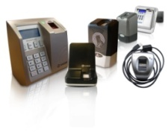
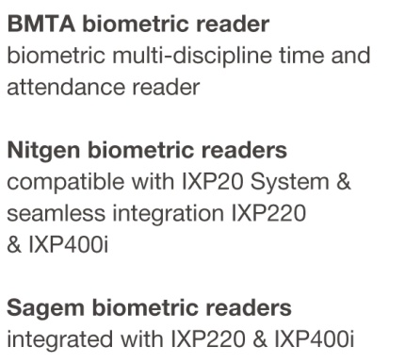
Readers
XTT901-1-0-GB
XTT950-1-0-GB
MDR900-5-0-GB 9 CORE PIGTAIL VERSION
WPR900-1-0-GB
ACCORDING to PRICE :IST
UHF900-1-0-GB
XTT902-1-0-GB
XTT951-1-0-GB
MDR901-5-0-GB 10 WAY TERMINAL BLOCK VERSION
WMR900-1-0-GB
XTT903-1-0-GB
XTT952-1-0-GB
MDK900-5-0-GB 9 CORE PIGTAIL VERSION
WMK900-1-0-GB
XTT904-1-0-GB
MDK901-5-0-GB 10 WAY TERMINAL BLOCK VERSION
WPK900-1-0-GB
XTT905-1-0-GB
WKM900-1-0-GB
XTT906-1-0-GB
WJB900-1-0-GB
XTT907-1-0-GB
XTT909-1-0-GB
IXP20TOUCH System Controllers iTRT Door Controller 125kHz Antenna Readers FINGKEY Access Plus I mpro provide a wide
IXP20NET System Controllers wiegand for 3rd party Wiegand Readers for 3rd party Biometric Reader range of high quality RFID
iTT Door Controller Multi- Discipline Readers tags for use with their range
reads 125kHz antenna readers of access control systems
Notes:
This is just to show images of all the different products … let animation finish

Slide 20
Readers
XTT901-1-0-GB
XTT950-1-0-GB
MDR900-5-0-GB 9 CORE PIGTAIL VERSION
WPR900-1-0-GB
ACCORDING to PRICE :IST
UHF900-1-0-GB
XTT902-1-0-GB
XTT951-1-0-GB
MDR901-5-0-GB 10 WAY TERMINAL BLOCK VERSION
WMR900-1-0-GB
XTT903-1-0-GB
XTT952-1-0-GB
MDK900-5-0-GB 9 CORE PIGTAIL VERSION
WMK900-1-0-GB
XTT904-1-0-GB
MDK901-5-0-GB 10 WAY TERMINAL BLOCK VERSION
WPK900-1-0-GB
XTT905-1-0-GB
WKM900-1-0-GB
XTT906-1-0-GB
WJB900-1-0-GB
XTT907-1-0-GB
XTT909-1-0-GB
Notes:
This is just to show images of all the different products … let animation finish

Slide 21





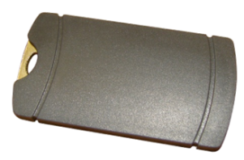



Tags
variety of tags used in the IXP20
access control system
Notes:
Adhesive Tag ….asset management … try to remove it and it damages the coil and u cant re-use

Slide 22


